Slide 1
Al-Farabi Kazakh National University
Higher School of Medicine
Epigenetics
Lecturer: PhD Pinsky Ilya Vladimirovich

Slide 2
LEARNING OUTCOMES
As a result of the lesson you will be able to:
explain the importance of epigenetic regulation and its role in heritability of cellular traits;
explain the role of DNA methylation in regulation of gene expression;
explain the mechanism of RNAi;
describe chromatin structure at the levels of organization: nucleosome, 30-nm fiber, chromosome;
explain the effects of histones on transcription; explain how transcription is affected by: nucleosome positioning, histone acetylation and methylation, chromatin remodeling;
describe the mechanisms and major players of above mentioned processes.

Slide 3
Literature
Alberts et al., pp. 194-207; Alberts et al., pp. 404-413; Alberts et al., pp. 429-436;
Weaver, pp. 355-387; Weaver, pp. 488-507.
Sarah A. Wojiski. Identical Twins, Identical Fates? An Introduction to Epigenetics // Case study. - School of Arts and Sciences, Massachusetts College of Pharmacy and Health Sciences, Boston, MA. https://sciencecases.lib.buffalo.edu/collection/detail.html?case_id=656&id=656

Slide 4
Epigenetics is the study of heritable changes in gene expression (active versus inactive genes) that do not involve changes in the underlying DNA sequence — a change in phenotype without a change in genotype — which in turn affects how cells read the genes. Epigenetic change is a regular and natural occurrence but can also be influenced by several factors including age, the environment/lifestyle, and disease state. Epigenetic modifications can manifest as commonly as the manner in which cells terminally differentiate to end up as skin cells, liver cells, brain cells, etc. Or, epigenetic change can have more damaging effects that can result in diseases like cancer.
So, epigenetics is the science about the regulation of gene expression at the molecular level.

Slide 5
https://sciencecases.lib.buffalo.edu/collection/detail.html?case_id=656&id=656

Slide 6
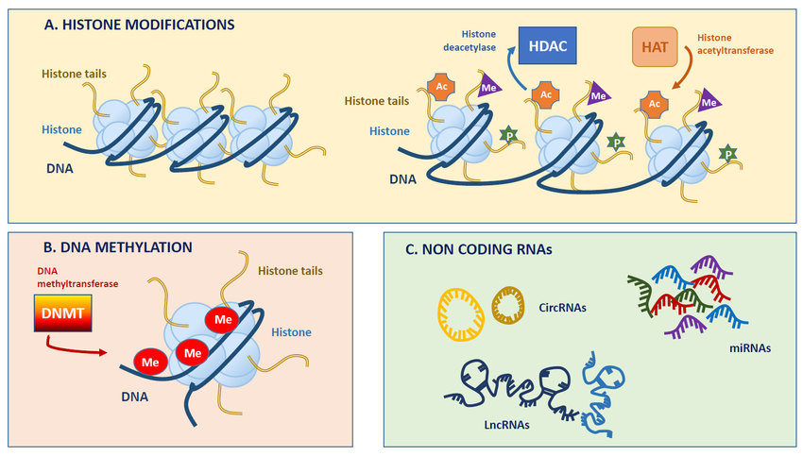
https://www.researchgate.net/figure/Simplified-overview-of-main-epigenetic-modifications-A-Chromosomal-DNA-is-packaged_fig1_333836553

Slide 7
Figure 1. Methylation of cytosine to form 5-methylcytosine. SAM (S-adenosyl methionine) serves as the source of the methyl group, giving SAH (S-adenosyl-L-homocysteine) as a by-product.
https://sciencecases.lib.buffalo.edu/collection/detail.html?case_id=656&id=656

Slide 8
Figure 2. Differential DNA methylation between two sets of monozygotic twins, one set at age 3 (left), one set at age 50 (right) using AIMS (amplification of intermethylated sites). Different bands, corresponding to sibling-specific changes of DNA methylation, are indicated with arrows. (Panel A of Figure 2 in Fraga et al., 2005. Epigenetic differences arise during the lifetime of monozygotic twins. PNAS 102:10604–10609. Copyright 2005 National Academy of Sciences, USA.)
https://sciencecases.lib.buffalo.edu/collection/detail.html?case_id=656&id=656

Slide 9
Figure 3. Mapping of chromosomal regions with differential DNA methylation in monozygotic twins using comparative genomic hybridization for methylated DNA. Four representative chromosome pairs are shown. Methylated DNA from one twin was labeled with a red fluorescent dye, while methylated DNA from the other twin in the pair was labeled with a green dye. Both sets of twin DNA were hybridized to normal metaphase chromosomes. The yellow color represents equal amounts of red and green dye hybridizing to the chromosomes, indicative of similar levels of DNA methylation at those particular chromosomal locations. (Figure 3 of Fraga et al., 2005. Epigenetic differences arise during the lifetime of monozygotic twins. PNAS 102:10604–10609. Copyright 2005 National Academy of Sciences, USA.)
https://sciencecases.lib.buffalo.edu/collection/detail.html?case_id=656&id=656

Slide 10
For example, one of the jobs of the liver is to remove toxic substances like alcohol from the bloodstream. To do this, liver cells express genes encoding subunits (pieces) of an enzyme called alcohol dehydrogenase. This enzyme breaks alcohol down into a non-toxic molecule. The neurons in a person's brain don’t remove toxins from the body, so they keep these genes unexpressed, or “turned off.” Similarly, the cells of the liver don’t send signals using neurotransmitters, so they keep neurotransmitter genes turned off.

Slide 11
How do cells "decide" which genes to turn on?
Broadly speaking, we can say that a cell's gene expression pattern is determined by information from both inside and outside the cell.
Examples of information from inside the cell: the proteins it inherited from its mother cell, whether its DNA is damaged, and how much ATP it has.
Examples of information from outside the cell: chemical signals from other cells, mechanical signals from the extracellular matrix, and nutrient levels.

Slide 12
A growth factor is a chemical signal from a neighboring cell that instructs a target cell to grow and divide. We could say that the cell "notices" the growth factor and "decides" to divide, but how do these processes actually occur?

Slide 13
Eukaryotic gene expression can be regulated at many stages
Eukaryotic gene expression involves many steps, and almost all of them can be regulated. Different genes are regulated at different points, and it’s not uncommon for a gene (particularly an important or powerful one) to be regulated at multiple steps.
Chromatin accessibility. The structure of chromatin (DNA and its organizing proteins) can be regulated. More opened or “relaxed” chromatin makes a gene more available for transcription.
Transcription. Transcription is a key regulatory point for many genes. Sets of transcription factor proteins bind to specific DNA sequences in or near a gene and promote or repress its transcription into an RNA.
RNA processing. Splicing, capping, and addition of a poly-A tail to an RNA molecule can be regulated, and so it can exit from the nucleus. Different mRNAs may be made from the same pre-mRNA by alternative splicing.

Slide 15
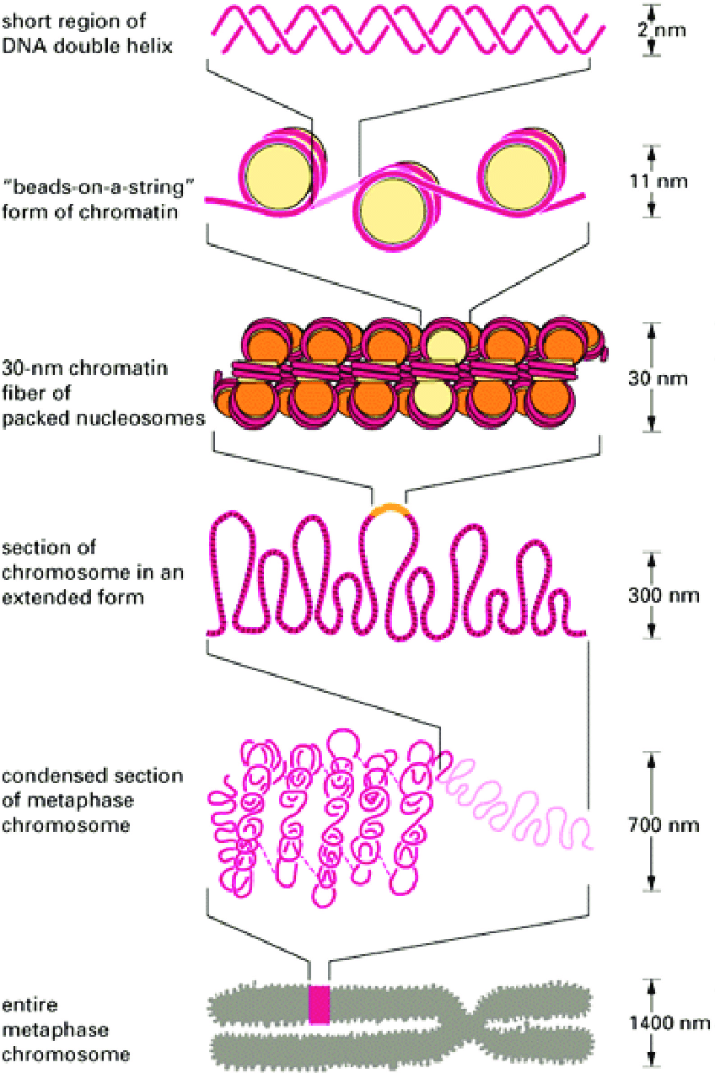
https://www.google.com/url?sa=i&url=https%3A%2F%2Fwww.researchgate.net%2Ffigure%2FChromatin-structure-http-csma31csmjmuedu-chemistry-faculty-mohler-chromatinhtm_fig17_322565060&psig=AOvVaw32leZizUvl4BeDvGElBppW&ust=1636375234179000&source=images&cd=vfe&ved=2ahUKEwjgn9j1oob0AhVtl4sKHcSACA0Qr4kDegUIARDLAQ

Slide 20
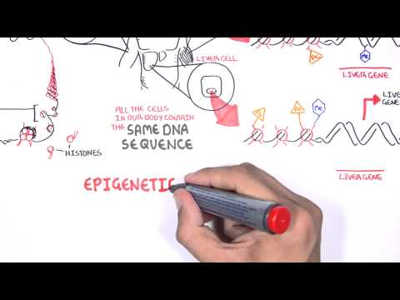

Slide 21
